Slide 1
Capstone Project - 4
Book Recommender System By:- Rohit Kumar Sharma

Slide 2

Let’s Catch The Defaulters
Defining problem statement
EDA
Popularity Based Approach
Collaborative Based Approach
Conclusion

Slide 3

Defining Problem Statement
Finding relevant books from a huge e-book space has become a tremendous difficulty for internet users as even the volume of online books grows tremendously as a result of the COVID-19 epidemic. A recommender system will help users who do not have enough individual knowledge to pursue through the different types of options offered by a website. It will provide the users with information to assist them to make a decision as to which items to purchase. The challenge with the recommendation system is predicting the users' opinions on various substances and being able to recommend the best goods to each user.

Slide 4
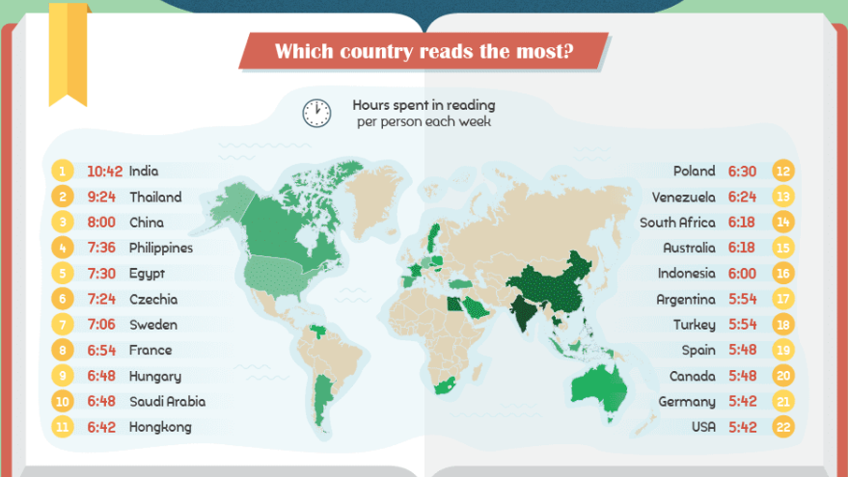
World Reading Habits

Slide 5
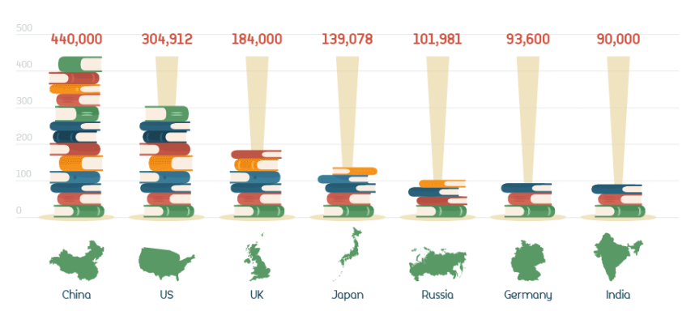
Which country publishes the most books each year?

Slide 6
Data Pipeline
Data processing- 1 :
In this first part we’ve removed unnecessary features, renaming columns. Since there are large number of columns with null values
EDA :
In this part, we will handle missing values and see the distribution of data. We also compare independent variable.
Popularity based approach:
In this part we will try to capture all the important, interesting features in a data set with respect to an outcome variable.
Collaborative based approach:
In this part we will try to capture small glance on collaborative approach and explain about there types.
Conclusion:
In this part we will give a conclusion whether these two algorithms are giving good results or not.

Slide 7
Data summary
We have 3 files in our dataset which is extracted from some books selling websites.
Books – This file is about books which contain all the information related to books like an author, title, publication year, etc.
Users – The second file contains registered user’s information like user id, location.
Ratings – Ratings contain information like which user has given how much rating to which book.

Slide 8
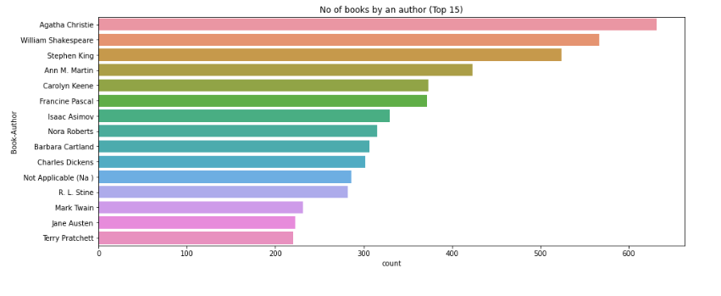
EDA – Book Author

Slide 9
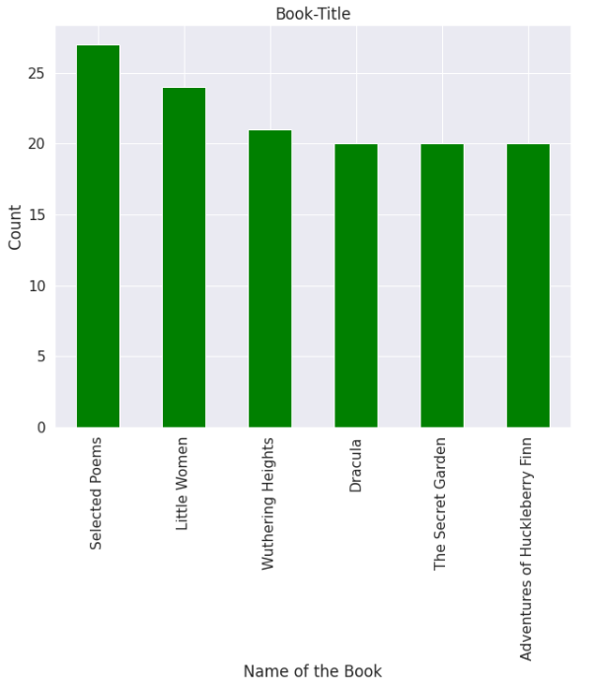
EDA – Book Title
This graph shows how many time book is republished:- Selected poems is republished may times.

Slide 10
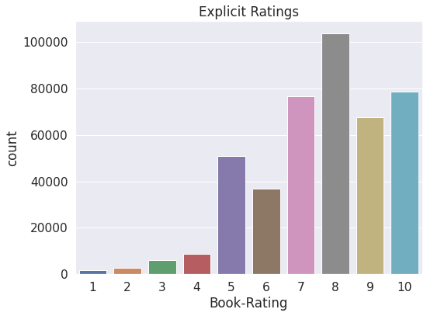
EDA- Count of all types of ratings
This graph shows what is the count of different rating.
Max is:- 8
Min is:- 1

Slide 11
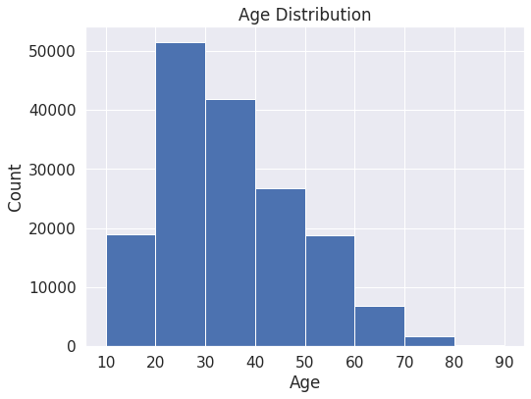
EDA – Age Distribution
This graph shows age distribution:-
People between 20-40 are reading more as compared to other age.

Slide 12
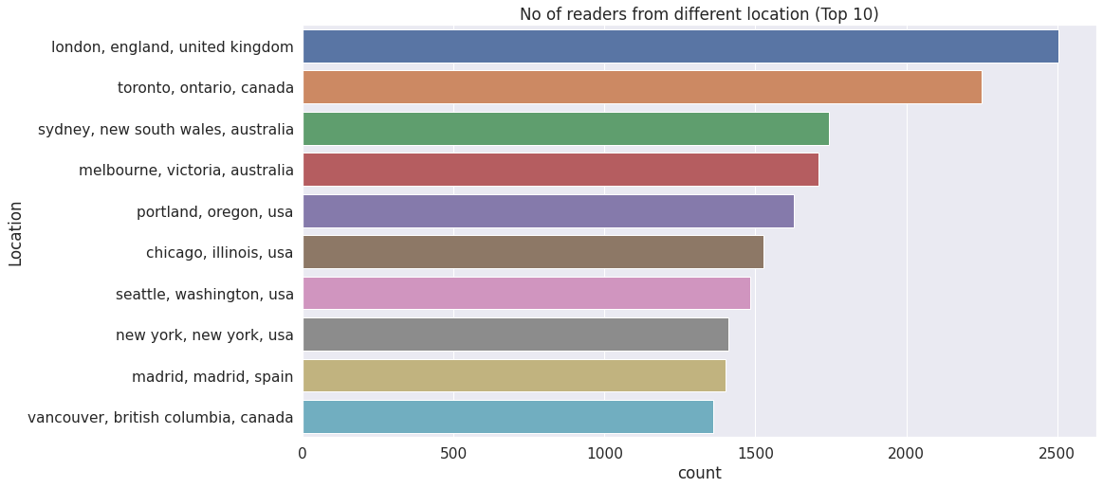
EDA - Location
This graph shows distribution of location

Slide 13
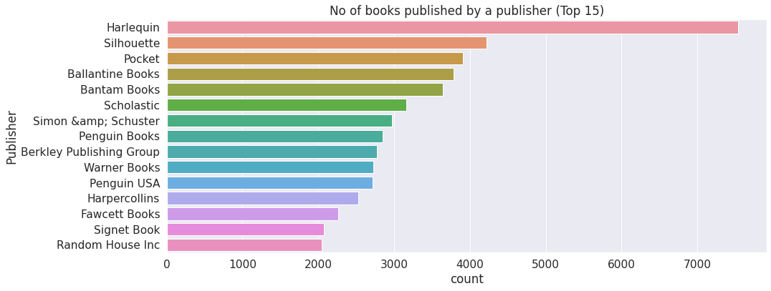
EDA - Publisher
This graph shows that Harlequin published maximum books.

Slide 14
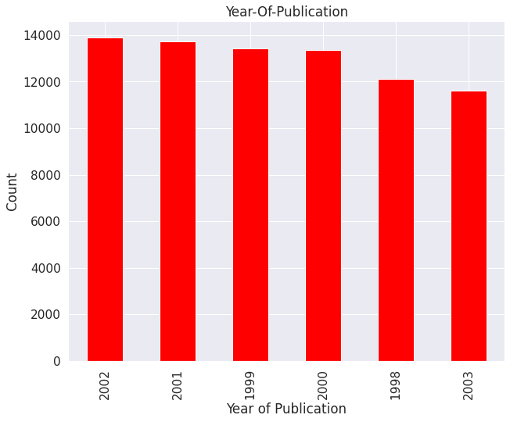
EDA – Year-of-publication
This graph shows distribution of year of publication
Maximum books were published on 2002.

Slide 15
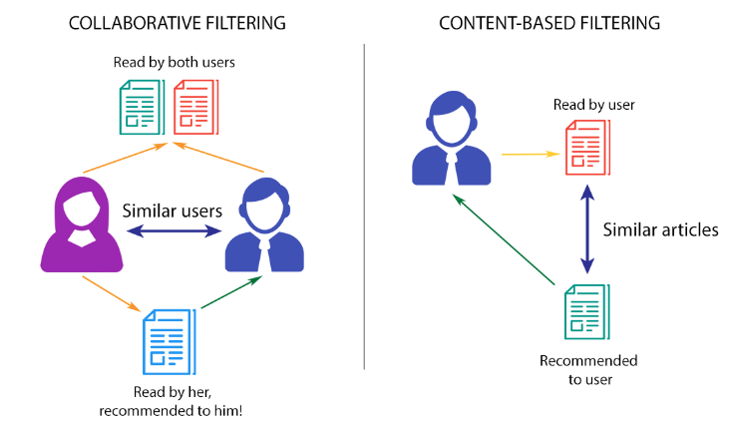
Techniques Used:-

Slide 16
Popularity Based Approach
It's a form of recommendation system that works on the basis of popularity or anything that's currently popular. These algorithms look for products or movies that are currently trending or popular among consumers and then immediately recommend them.
For example, if a product is frequently purchased by the majority of people, the system will learn that it is the most popular, and it will recommend that product to every new user who has just joined up, increasing the likelihood that the new user would purchase it as well.
More Example: Google news, YouTube Trending Videos

Slide 17
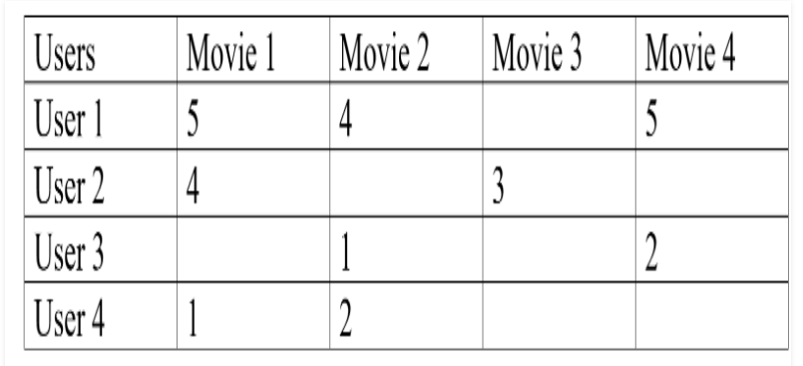
Collaborative Filtering Based Recommender System
The practice of filtering for information or patterns employing strategies incorporating collaboration among numerous agents, viewpoints, data sources, and so on is known as collaborative filtering. Collaborative filtering is often used with very big data sets.
Example:- Amazon is known for its use of collaborative filtering, matching products to users based on past purchases. For example, the system can identify all of the products a customer and users with similar behaviors have purchased and/or positively rated.

Slide 18
Difference between Popular and Collaborative
Popular Based
It requires good amount of information about items’ features, rather than using the user’s interactions and feedback.
This technique requires a lot of domain knowledge to be fed with.
we have to know the content of both user and item.
Collaborative based
It requires only the user’s historical data, the core assumption made is that the users who have agreed in the past will also tend to agree in the future.
This technique does not requires a lot of domain knowledge to be fed with.
The collaborative algorithm uses only user behavior for recommending items.

Slide 19
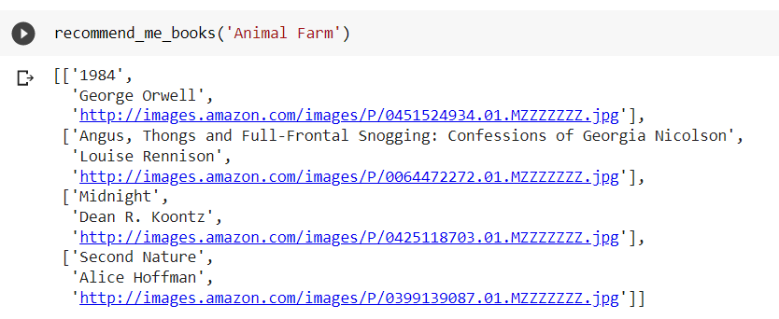
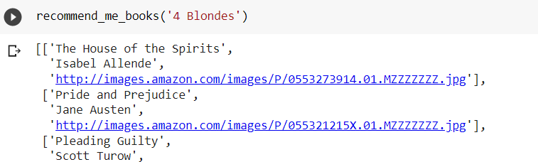
Final results

Slide 20
Conclusion
The escalating demands of Online Data have led to the invention of new techniques for presenting or rather recommending different products to the users. This project uses Popularity based as well as Collaborative filtering in order to recommend different types of books to the users. Both these techniques get rid of the Data sparsity and Cold Start Problem. Finally, the calculations of both the algorithms give accurate results.

Slide 21
Challenges
Huge chunk of data was to be handled keeping in mind to miss anything which is even of little relevance.
As there were three dataset finding correlation was challenge
Computation time (especially during Loading data)
Quite large Dataset.

Slide 22
Thank You

